Slide 1
Triple Generative Adversarial Nets
NIPS2017
Chongxuan Li, Kun Xu, Jun Zhu , Bo Zhang
Dept. of Comp. Sci. & Tech., TNList Lab, State Key Lab of Intell. Tech. & Sys.,
Center for Bio-Inspired Computing Research, Tsinghua University, Beijing, 100084, China

Slide 2
1.Abstract
However, existing GANs in SSL have two problems: (1) the generator and the discriminator (i.e. the classifier) may not be optimal at the same time; and (2) the generator cannot control the semantics of the generated samples.
To address the problems, we present triple generative adversarial net (Triple-GAN), which consists of three players—a generator, a discriminator and a classifier.

Slide 3
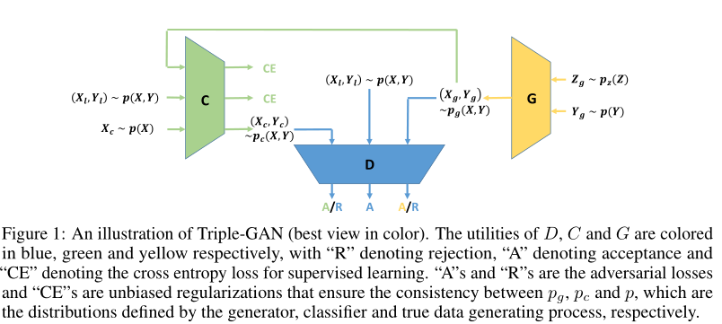
2.Method

Slide 4
2.Method
2.1 A Game with Three Players
Triple-GAN consists of three components:
(1) a classifier C that (approximately) characterizes the conditional distribution
p_{c} (y|x) ≈ p(y|x) ;
(2) a class-conditional generator G that (approximately) characterizes the conditional distribution in the other direction p_{g} (x|y) ≈ p(x|y);
(3) a discriminator D that distinguishes whether a pair of data (x,y) comes from the true distribution p(x,y)

Slide 5
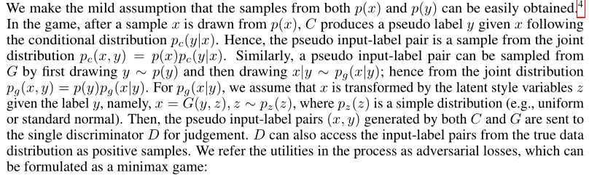
2.Method
2.1 A Game with Three Players

Slide 6
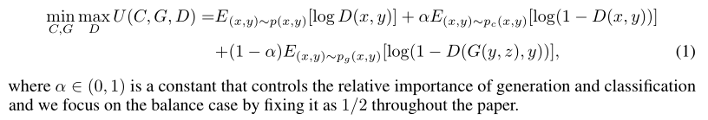
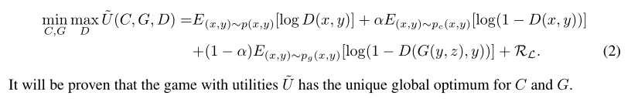
2.Method
2.1 A Game with Three Players

Slide 7
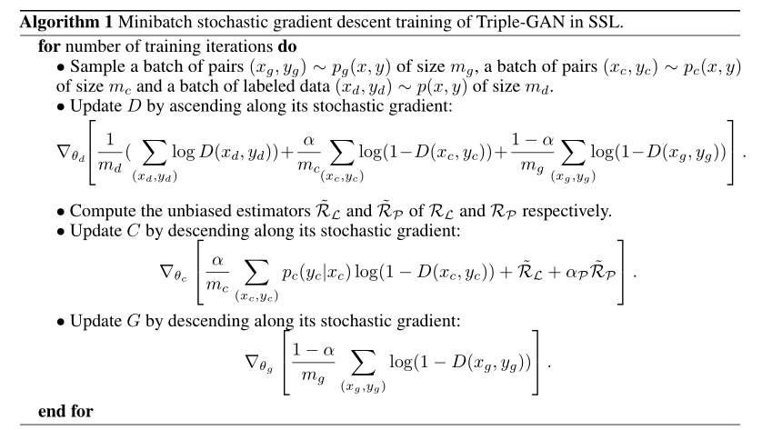
2.Method
2.2 Theoretical Analysis and Pseudo Discriminative Loss

Slide 8
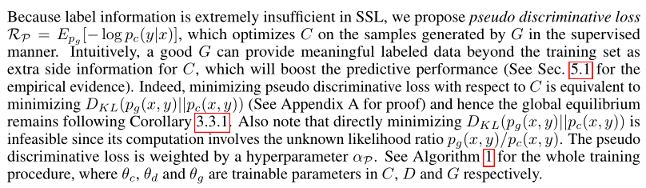
2.Method
2.2 Theoretical Analysis and Pseudo Discriminative Loss

Slide 9
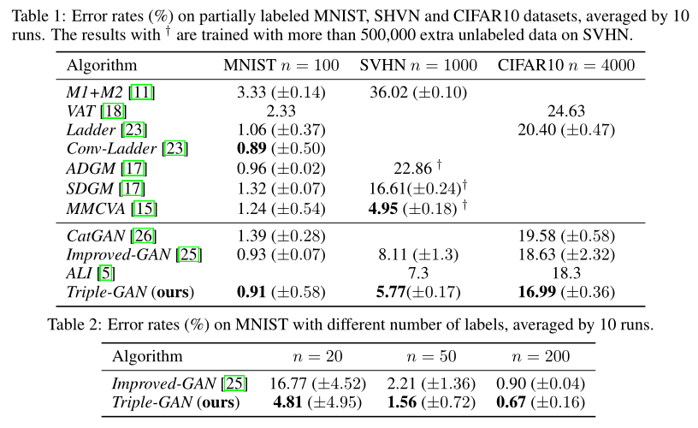
3.Experiments

